Slide 1
Dynamic Route Scheduling, Holland
* routes determined dynamically
* tiered network of buses
* large buses assigned cross-town routes
* smaller buses aggregate local riders
* mobile app with GPS locates riders
* capacity, traffic update routing dynamically

Slide 2
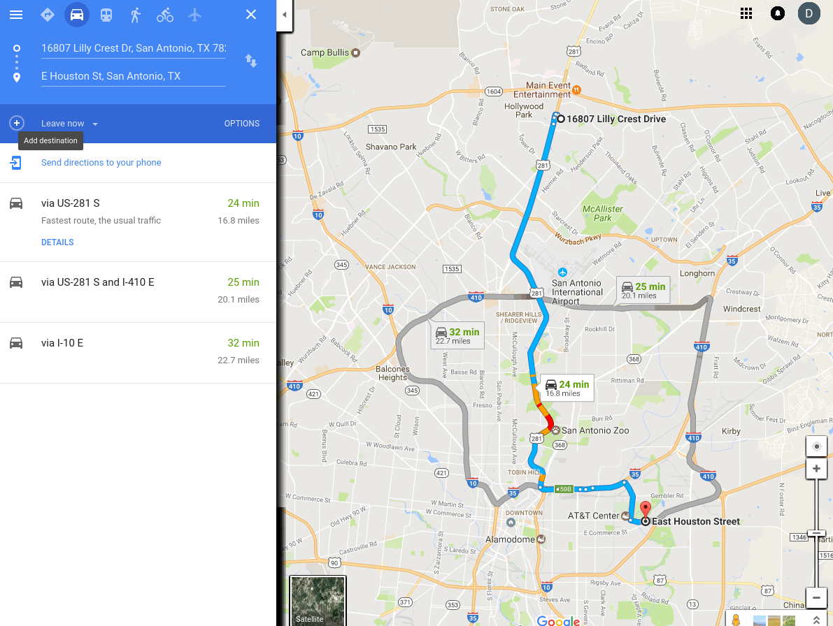
Route Map

Slide 3
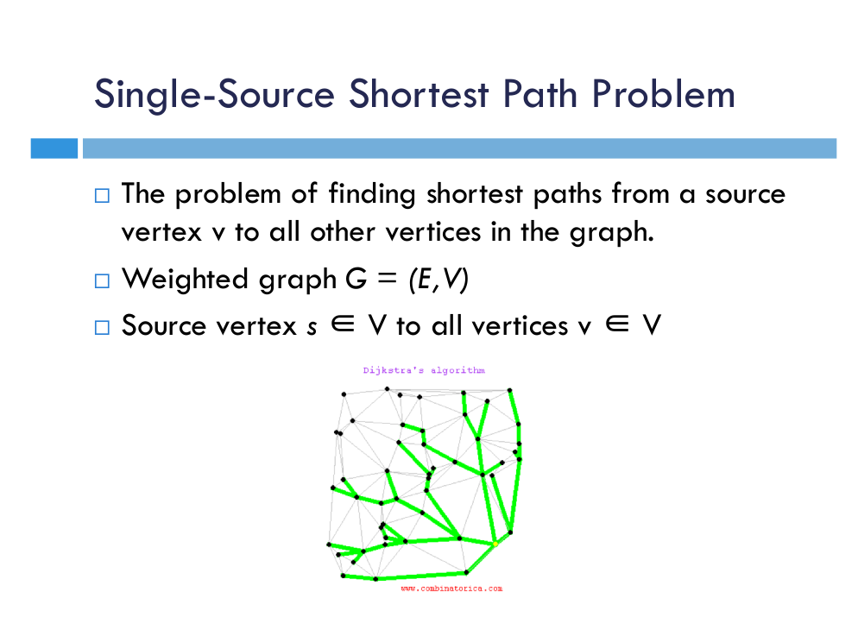
Routing Algorithm

Slide 4
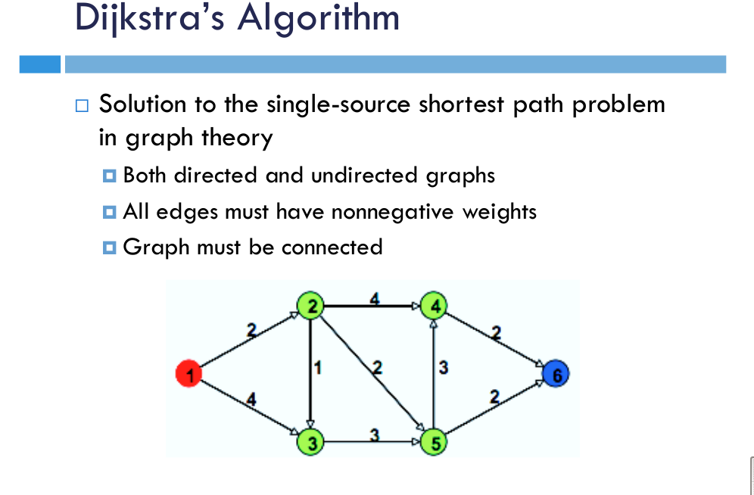

Slide 5
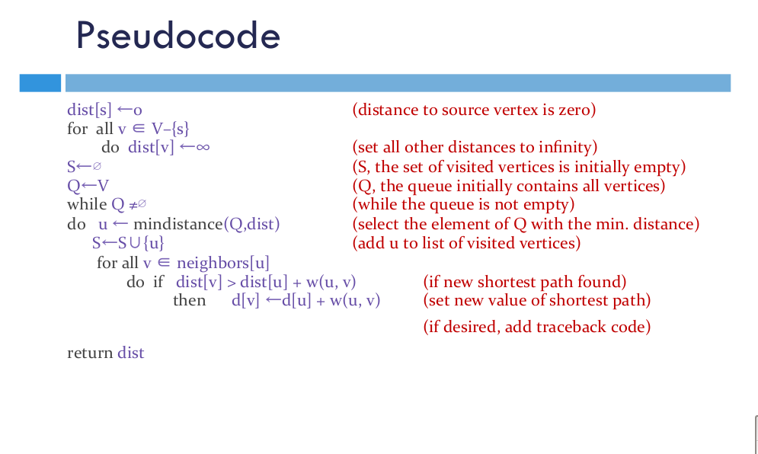

Slide 6
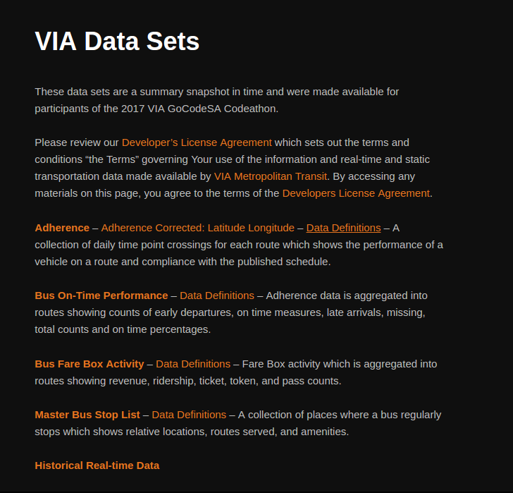
http://www.gocodesa.com/viadata/

Slide 7
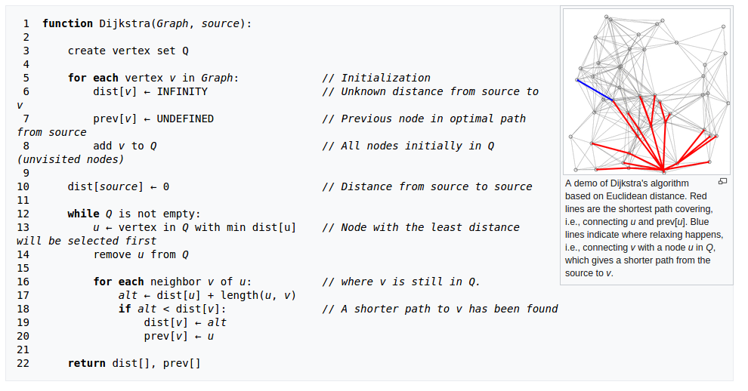

Slide 8
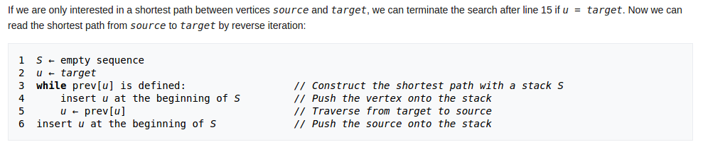
Get Path

Slide 9
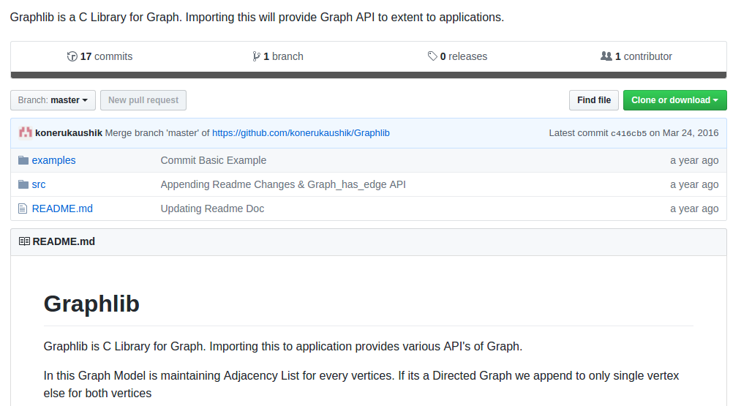
https://github.com/konerukaushik/Graphlib

Slide 10
Graph_t* Graph_init(int, bool);
Graph_vertices_t* Graph_add_vertices(Graph_t*, int);
void Graph_display_graph(const Graph_t *);
Graph_t * Graph_add_edge(Graph_t *, vertex_number_t, vertex_number_t, edge_weight_t , bool);
void Graph_get_dijsktra(Graph_t *, vertex_number_t );
bool Graph_has_edge(Graph_t *, vertex_number_t , vertex_number_t);
// Misc Function Declarations
bool Graph_node_in_adjacency(Graph_edges_t *, vertex_number_t);
Graph_vertices_t * Graph_get_vertex(Graph_t *, vertex_number_t);

